Slide 1
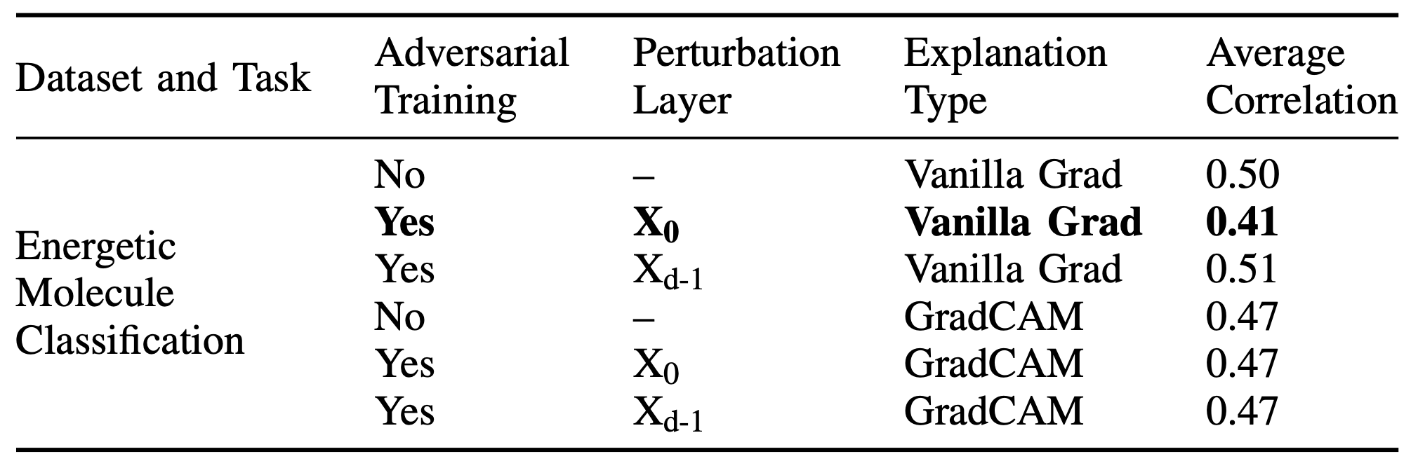
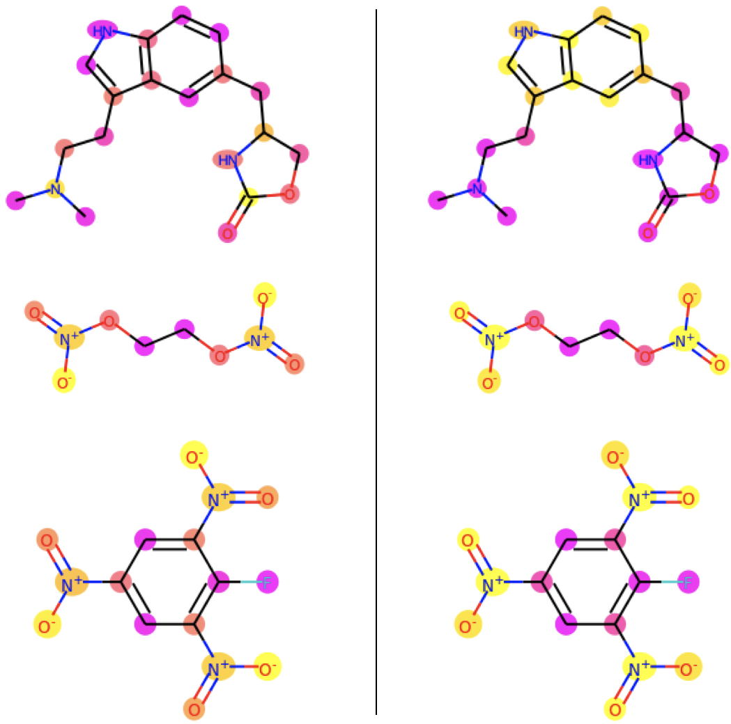

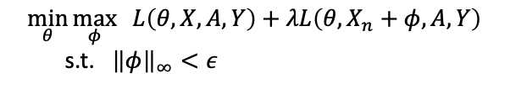
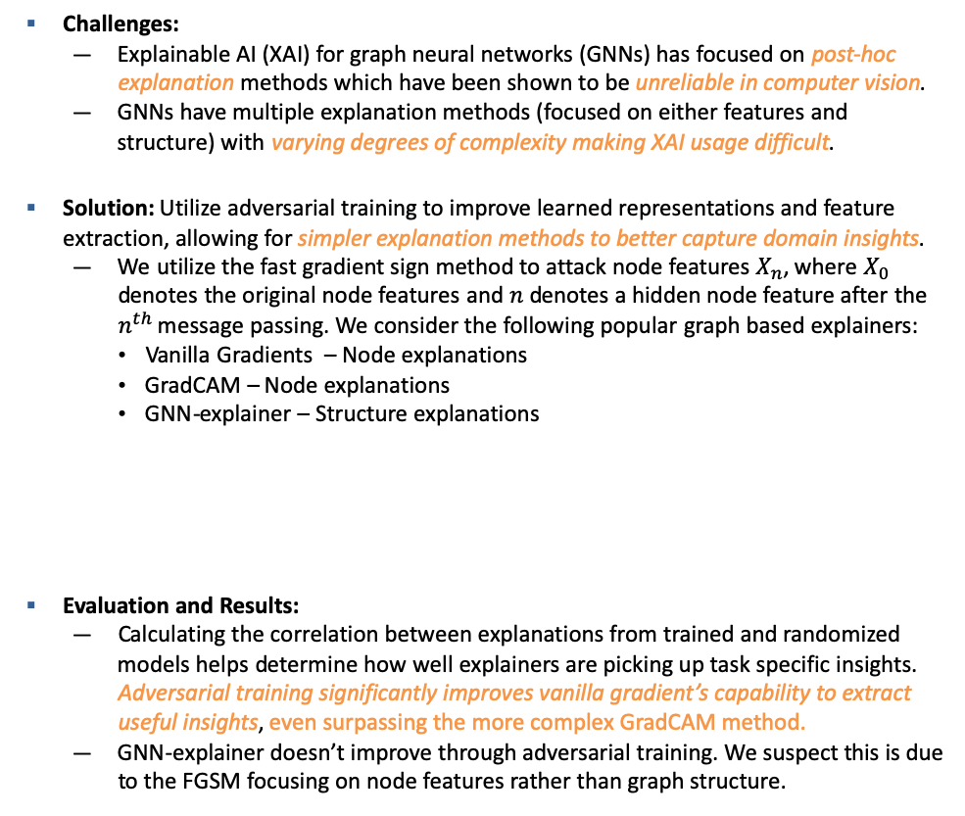
Reliable Graph Neural Network Explanations Through Adversarial Training
Donald Loveland¹, Shusen Liu², Bhavya Kailkhura², Anna Hiszpanski¹, Yong Han¹
¹Materials Science Department, ²Center for Applied Scientific Computing
Challenges:
Explainable AI (XAI) for graph neural networks (GNNs) has focused on post-hoc explanation methods which have been shown to be unreliable in computer vision.
GNNs have multiple explanation methods (focused on either features and structure) with varying degrees of complexity making XAI usage difficult.
Solution: Utilize adversarial training to improve learned representations and feature extraction, allowing for simpler explanation methods to better capture domain insights.
We utilize the fast gradient sign method to attack node features $X_{n}$, where $X_{0}$ denotes the original node features and $n$ denotes a hidden node feature after the $n^{th}$message passing. We consider the following popular graph based explainers:
Vanilla Gradients – Node explanations
GradCAM – Node explanations
GNN-explainer – Structure explanations
Evaluation and Results:
Calculating the correlation between explanations from trained and randomized models helps determine how well explainers are picking up task specific insights. Adversarial training significantly improves vanilla gradient’s capability to extract useful insights, even surpassing the more complex GradCAM method.
GNN-explainer doesn’t improve through adversarial training. We suspect this is due to the FGSM focusing on node features rather than graph structure.
Non-adversarial Explanations
Adversarial Explanations
Adversarial Training Procedure
Predictive Loss
Adversarial Loss
:
$$\min_{θ}{\max_{φ}{L\left(θ, X, A, Y\right)+λL\left(θ, X_{n}+φ, A, Y\right)}}$$
s.t. ${\left\|φ\right\|}_{∞}<ε$
Yellow and pink denote important and unimportant nodes, respectively. Adversarially trained models:
Produced more compact explanations
Better highlighted domain specific graph motifs such as connected rings and NO2 groups
This work was performed under the auspices of the U.S. Department of Energy by Lawrence Livermore National Laboratory under contract DE-AC52-07NA27344. Lawrence Livermore National Security, LCC.
LLNL-PRES-823811
Notes:
Highlight key points

